Slide 1
Chapter 9: Virtual Memory

Slide 2
Chapter 9: Virtual Memory
Background
Demand Paging
Copy-on-Write
Page Replacement
Allocation of Frames
Memory-Mapped Files
Allocating Kernel Memory
Other Considerations
Operating-System Examples

Slide 3
Objectives
Describe the benefits of a virtual memory system
Explain the concepts of demand paging, page-replacement algorithms, and allocation of page frames
Discuss the principle of the working-set model

Slide 4
Swapping
Total physical memory space of processes can exceed physical memory (RAM)
A process can be swapped (paged out) temporarily out of memory to a backing store, and then brought back into memory for continued execution
Backing store – fast disk large enough to accommodate copies of all memory images for all users; must provide direct access to these memory images
Swap out, Swap in – swapping variant used for priority-based scheduling algorithms; lower-priority process is swapped out so higher-priority process can be loaded and executed
Major part of swap time is transfer time; total transfer time is directly proportional to the amount of memory swapped
System maintains a ready queue of ready-to-run processes which have memory images on disk

Slide 5
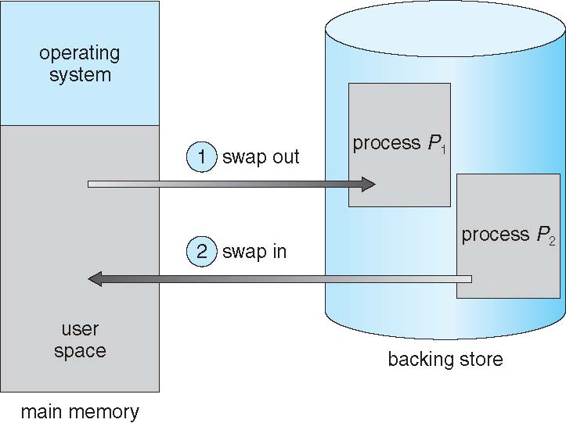
Schematic View of Swapping

Slide 6
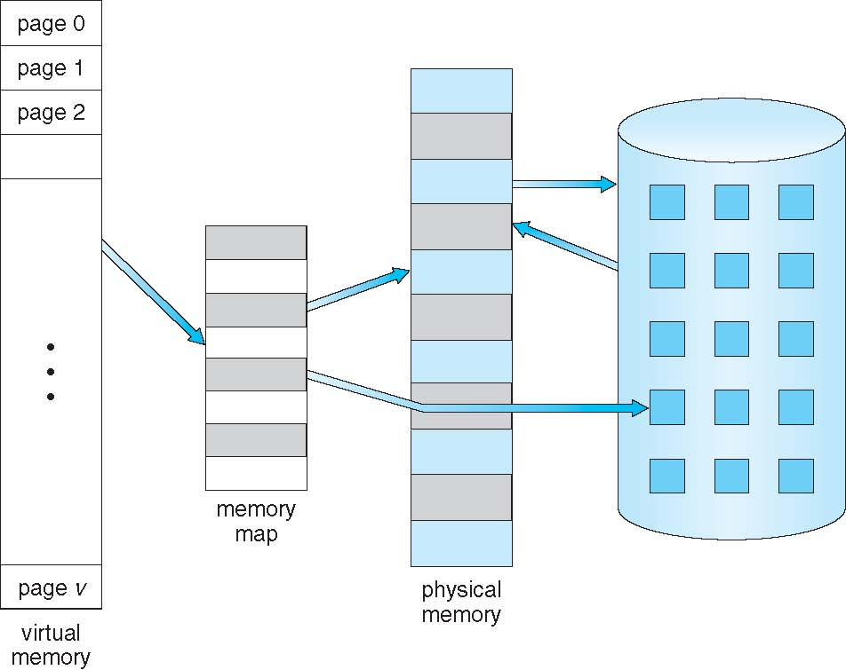
Virtual Memory That is Larger Than Physical Memory

Slide 7
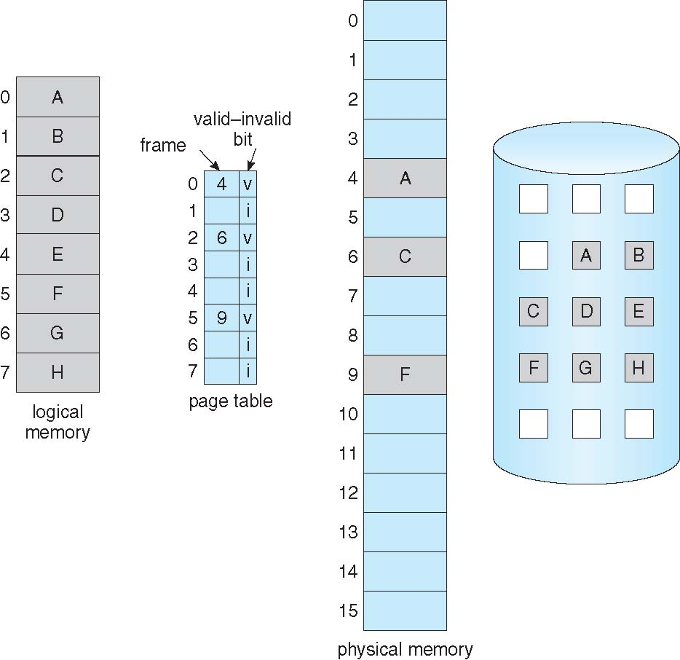
Page Table When Some Pages Are Not in Main Memory

Slide 8
Valid-Invalid Bit of PTE
If the valid bit of a PTE encountered during address translation is zero, the PTE represents an invalid page—one that will raise a memory management exception, or page fault, upon reference. The MMU ignores the remaining bits of the PTE, so the operating system can use these bits to store information about the page that will assist in resolving the page fault.
With each page table entry a valid–invalid bit is associated (v ⇒ in-memory – memory resident, i ⇒ not-in-memory)
Initially valid–invalid bit is set to i on all entries
During address translation, if valid–invalid bit in page table entry is I ⇒ page fault

Slide 9
Demand Paging
Demand paging is a common technique used in virtual memory systems, where processes located in disk are swapped into memory. But Instead of swapping the entire process, only the pages needed during the program execution are loaded into memory.
A page fault causes the following:
Trap to the operating system
Save the registers and process state (context switch)
Determine that the interrupt was a page fault
Check that the page reference was legal and determine the location of the page on the disk
Issue a read from the disk to a free frame:
Wait in a queue for this device until the read request is serviced
Wait for the device seek and/or latency time
Begin the transfer of the page to a free frame

Slide 10
Demand Paging
6. While waiting for I/O to complete, allocate the CPU to some other process
7. Receive an interrupt from the disk I/O subsystem (I/O completed)
8. Save the registers and process state for the other process (context switch)
9. Determine that the interrupt was from the disk
10.Correct the page table and other tables to show page is now in memory
11. Wait for the CPU to be allocated to this process again

Slide 11
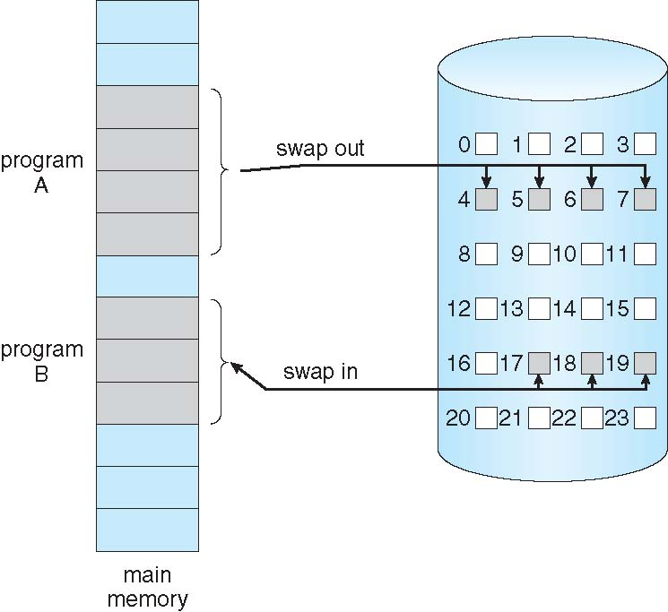
Transfer of a Paged Memory to Contiguous Disk Space

Slide 12
Page Fault
Accessing a page that isn’t resident in memory but is on disk in a page file or a mapped file
If there is a reference to a page, the first reference to that page will trap the operating system and generates a page fault
Operating system looks at another table to decide:
Invalid reference ⇒ abort
Just not in memory
Get empty frame
Swap page into frame via scheduled disk operation
Reset tables to indicate page now in memory Set validation bit = v
Restart the instruction that caused the page fault

Slide 13
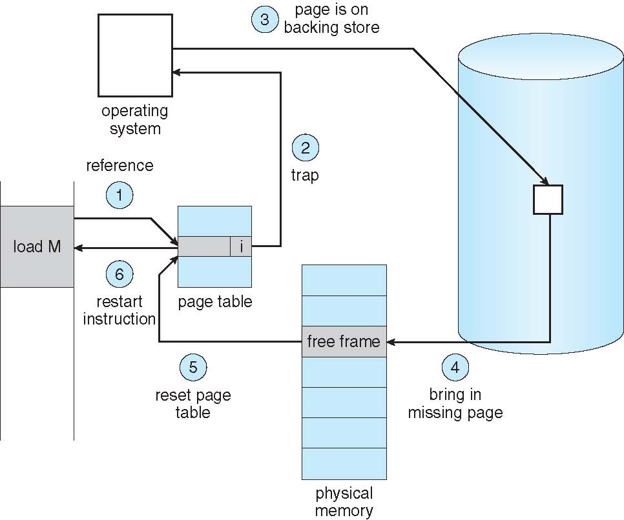
Steps in Handling a Page Fault

Slide 14
Windows Page File
Page file is used to store modified pages that are still in use by some process but have had to be written to disk. Page file space is reserved when the pages are initially committed.
The paging file is only one aspect of virtual memory. In fact, even if you run with no page file at all, Windows will still be using virtual memory.
Once the page files are open, they can’t be deleted while the system is running because the System process maintains an open handle to each page file.
Page File: \??\C:\pagefile.sys
Increasing the size of the page file does not change system performance, it simply means the system can have more committed virtual memory.

Slide 15
Windows Page File
The numeric value of system commit limit represents the amount of RAM available to Windows plus the current sizes of any page files. If a page file is expanded, or new page files are created, the commit limit increases accordingly. If no page files exist, the system commit limit is simply the total amount of RAM available to Windows.
Commit charge is the system-wide total of all “committed” memory allocations that must be kept in either RAM or in a paging file
If the page file is too small for the mix of applications you are running, you might get the “system running low on virtual memory” error message. In this case, first check to see whether a process has a memory leak.

Slide 16
Windows Commit Limit and Working Set
Commit Limit: Number of bytes of virtual memory that can be committed without having to extend the paging files; if the paging files can be extended, this limit is soft.
Working Set: Virtual Bytes that is currently in RAM and can be referenced without a page fault. The working set changes If a page is in active use, it will be in the working set, if it is not longer in use, it is dropped from working set.

Slide 17
Copy-on-Write Page
Copy-on-Write (COW) page protection is an optimization technique used by memory manager to conserve physical memory.
For example if two processes are sharing three pages, If a thread in either process writes to a page, a memory management fault is generated. The memory manager sees that the write is to a copy-on-write page, so instead of reporting the fault as an access violation, it allocates a new read/write page in physical memory, copies the contents of the original page to the new page, updates the corresponding page-mapping information in this process to point to the new location. A newly copied page is now private to the process that did the writing and isn’t visible to the other process still sharing the copy-on-write page. Each new process that writes to that same shared page will also get its own private copy.
Copy-on-Write (COW) allows both parent and child processes to initially share the same pages in memory. If either process modifies a shared page, only then is the page copied
COW allows more efficient process creation as only modified pages are copied
vfork() variation on fork() system call has parent suspend and child using copy-on-write address space of parent.

Slide 18
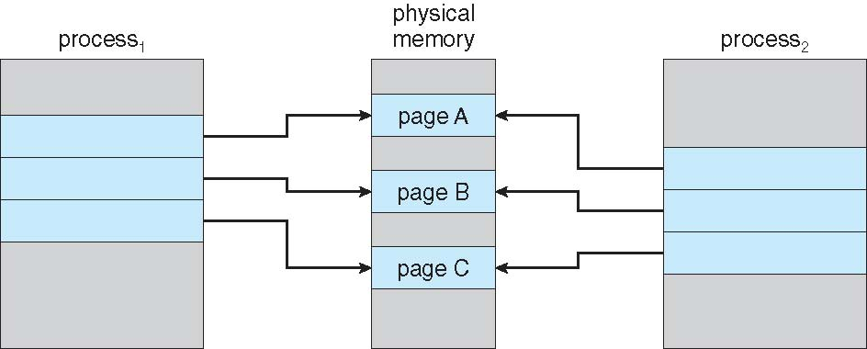
Before Process 1 Modifies Page C

Slide 19
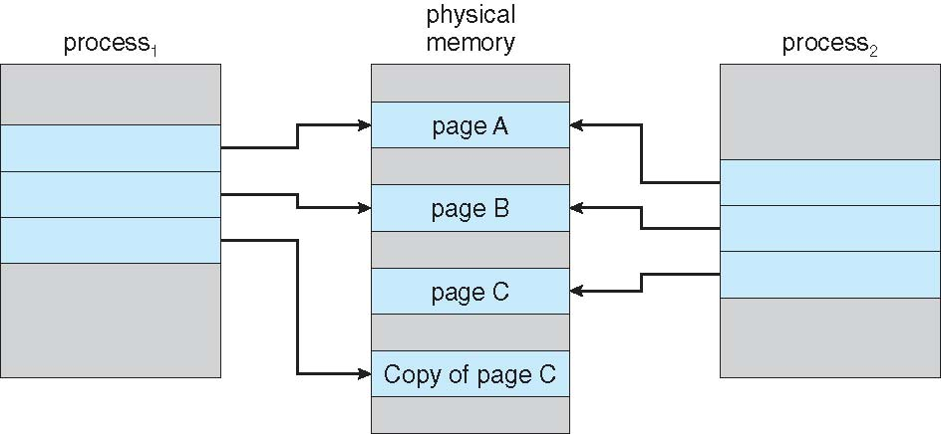
After Process 1 Modifies Page C

Slide 20
What happens if there is no Free Frame?
Page replacement algorithm– If no page frame is free, find some page in memory that is not currently in used and free it, page it out
Performance – want an algorithm which will result in minimum number of page faults
Evaluate algorithm by running it on a particular string of memory references (reference string) and computing the number of page faults on that string.
String is just page numbers, not full addresses
Repeated access to the same page does not cause a page fault
Same page may be brought into memory several times

Slide 21
Global vs. Local Allocation
Global replacement – process selects a replacement frame from the set of all frames; one process can take a frame from another process
But then process execution time can vary greatly
But greater throughput, so it is more common
Local replacement – each process selects from only its own set of allocated frames
More consistent per-process performance
But possibly underutilized memory

Slide 22
Page Replacement
Page replacement algorithm:
1. Find the location of the desired page on disk
2. Find a free frame: - If there is a free frame, use it - If there is no free frame, use a page replacement algorithm to select a
victim frame - Write victim frame to disk if dirty 3. Bring the desired page into the (newly) free frame; update the page and frame tables 4. Continue the process by restarting the instruction that caused the trap
The modify (dirty) bit is set by hardware whenever any byte in the page is written into, indicating that the page has been modified. When a page is selected for replacement, the system examines modified bit to decide if the page has to be written to disk or not. This technique reduces overhead of page transfers – only modified pages are written to disk

Slide 23
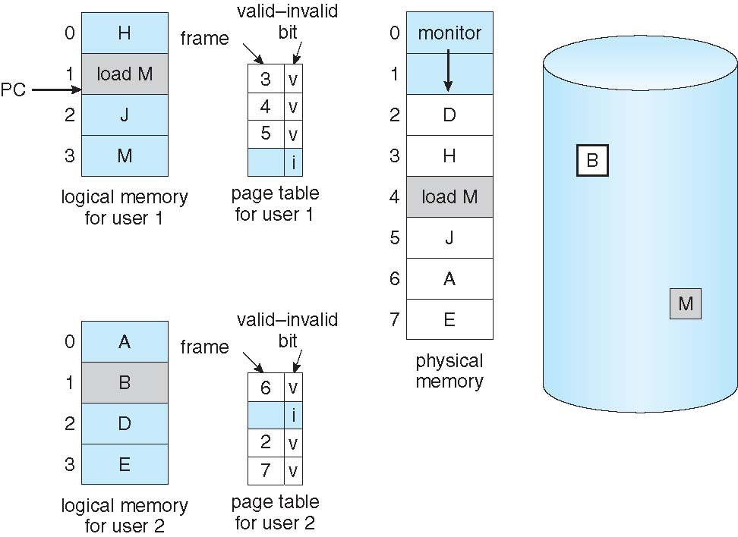
Need For Page Replacement

Slide 24
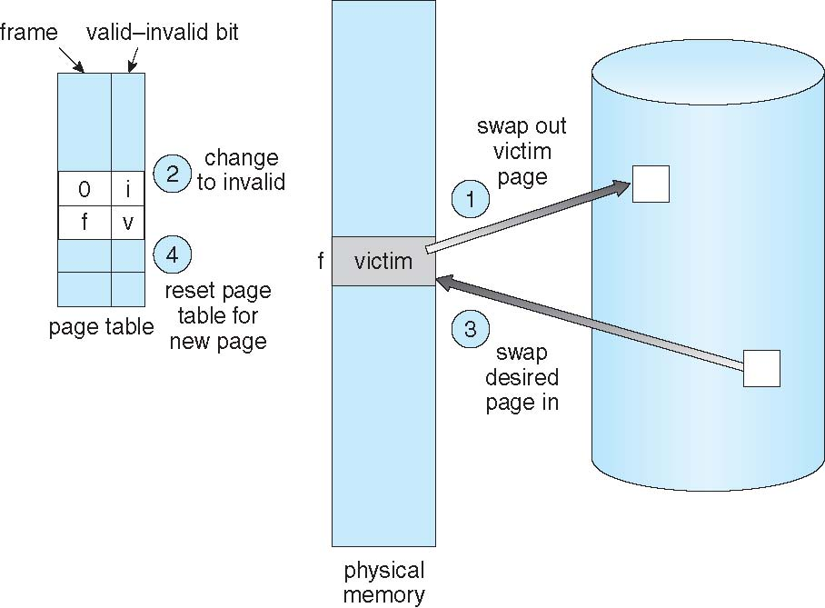
Page Replacement

Slide 25
Page and Frame Replacement Algorithms
FIFO
LRU (Least Recently Used )

Slide 26
FIFO
First-in, first-out (FIFO)
Treats page frames allocated to a process as a circular buffer
Simplest replacement policy to implement
Page that has been in memory the longest is replaced

Slide 27
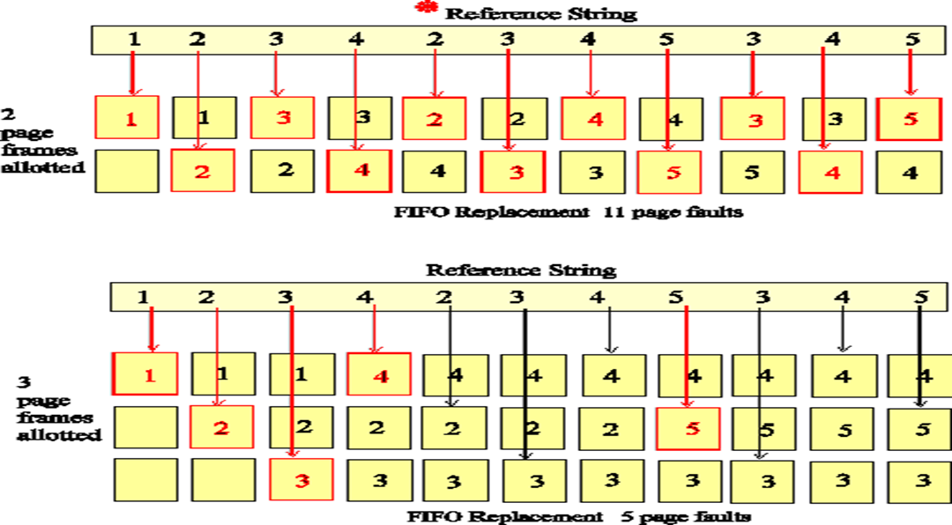
FIFO Replacement

Slide 28
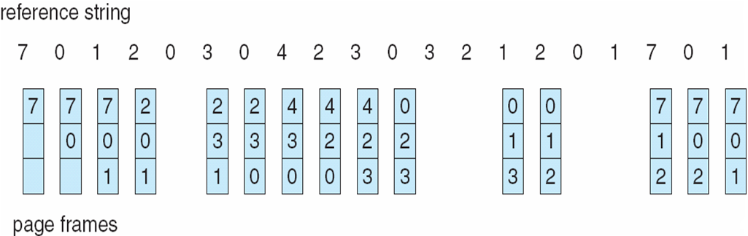
FIFO Page Replacement

Slide 29
Least Recently Used LRU
When a page must be replaced, LRU chooses that page that has not been used for the longest period of time
Use past knowledge rather than future
Generally good algorithm and frequently used
To implement LRU is necessary to keep a stack of page numbers with the most recently used page on the top and the LRU at the bottom
Counters- clock incremented for every memory reference
Notes:
The Least Recently Used replacement policy chooses to replace the page which has not been referenced for the longest time. This policy assumes the recent past will approximate the immediate future. The operating system keeps track of when each page was referenced by recording the time of reference or by maintaining a stack of references.
LRU is a stack algorithm removal policy – increasing main memory causes either a decrease in or same number of page interrupts.
LRU doesn’t have same anomaly that FIFO does.
The LRU algorithm looks at all three bits in the PMT before deciding which pages to swap out. (Text Book page 61)
LRU can be implemented with
counters : whenever a reference to a page is made , the contents of the clock register are copied to the time-of use field in the page table entry for that page. In this way, the system always have the time of the last reference to each page.
Stack:the top of the stack is always the most recently used page and the bottom is the LRU (example on next slide)
Text Book Page 59

Slide 30
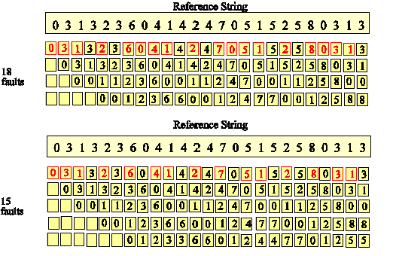
LRU Replacement
Notes:
The Least Recently Used diagram above illustrates the LRU algorithm.
Notice that the most recently accessed page is now represented by the top page rectangle. The rectangles do not represent specific page frames as they did in the FIFO diagram. Thus, each reference necessitating a page fault (shown in red) is now on the top row.
Further inspection will show that as more pages are allotted to the program the page references in each row do not change. Only the number of page faults changes. The set of pages in memory for n pages is thus a subset of the set of pages for n + 1 page frames. In fact, the diagram could be considered a STACK data structure with the depth of the stack representing the number of page frames. If a page is not on the stack (i.e. is found a depth greater than the number of page frames) then a page fault occurs.
Reference: http://cne.gmu.edu/modules/vm/yellow/lru.html
More examples in the Text Book pages 59 and 60

Slide 31
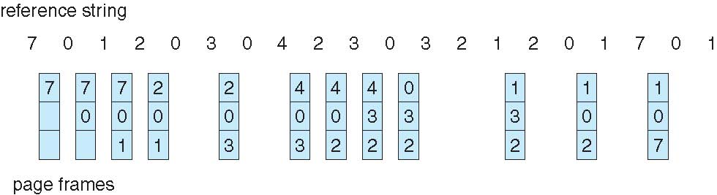
Least Recently Used (LRU) Algorithm

Slide 32
Allocating Kernel Memory
Treated differently from user memory
Often allocated from a free-memory pool
Kernel requests memory for structures of varying sizes
Some kernel memory needs to be contiguous
I.e. for device I/O
Two techniques use to allocate kernel memory
Buddy System allocator
Slab allocator

Slide 33
Buddy System
Allocates memory from fixed-size segment consisting of physically-contiguous pages
Memory allocated using power-of-2 allocator
Satisfies requests in units sized as power of 2
Request rounded up to next highest power of 2
When smaller allocation needed than is available, current chunk split into two buddies of next-lower power of 2
Continue until appropriate sized chunk available
For example, assume 256KB chunk available, kernel requests 21KB
Split into A_{L} _{and} A_{r} of 128KB each
One further divided into B_{L} and B_{R} of 64KB
One further into C_{L} and C_{R} of 32KB each – one used to satisfy request
Advantage – quickly coalesce unused chunks into larger chunk
Disadvantage - fragmentation

Slide 34
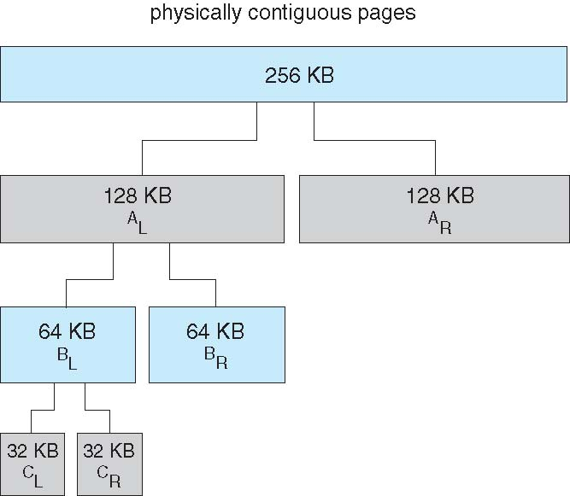
Buddy System Allocator

Slide 35
Slab Allocator
Slab is one or more physically contiguous pages
Cache consists of one or more slabs
Single cache for each unique kernel data structure
Each cache filled with objects – instantiations of the data structure
When cache is created is filled with objects marked as free
When data structures are stored, objects are marked as used
If slab is full of used objects, next object allocated from empty slab
If no empty slabs, new slab allocated
Benefits of slab allocator includes:
no fragmentation
fast memory request and access

Slide 36
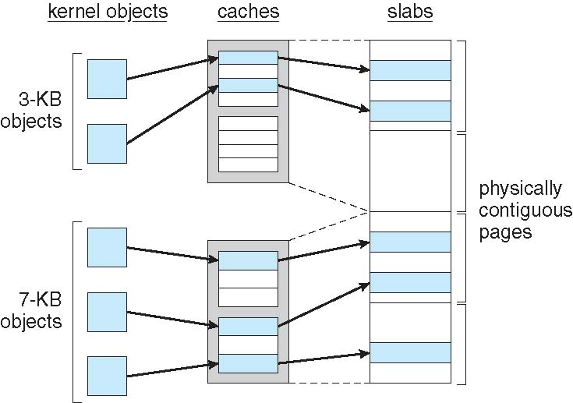
Slab Allocation

Slide 37
End of Chapter 8

